Slide 1
SUPERSTORES DATASET
Data Report presented: By Anita JIM
Assignment 1

Slide 2
TABLE OF CONTENTS
OVERVIEW
GETTING DATA INTO MS EXCEL
DATA EXPLORING AND UNDERSTANDING
DATA PREPARATION : Data Cleaning, Missing Data, Data Formats, Deriving New Variables and Looking up Data
ANALYSIS
CONCLUSION

Slide 3
OVERVIEW
This report is on a project called SuperStore Dataset. A series of actions are carried out on this data to gather important insights to make some business decisions. The actions carried out include:
Data Exploring and Understanding
Data cleaning and Editing which involves checking for missing data, correcting data formats, adding new variables when required
Analysis
Data Presentation

Slide 4
GETTING DATA INTO MS EXCEL
According to the instruction a-g, our data set was gotten from the combination of three different data to create a comprehensive dataset. The Superstores data set was a combination of three different datas provided, namely;
The sales transaction data
The returned items and,
The regional managers

Slide 5
2. DATA EXPLORING AND UNDERSTANDING
For data exploring and understanding, this involves investigating and reviewing the data present in each fields. The number of rows and columns in each data was determined, of which;
Sales transaction data accounts for the most number of rows and columns with 8,399 rows, 22 columns
Returned items accounts for 572 rows, 2 columns
Regional manager accounts for 8 rows, 2 columns.
Most of the fields format are ‘general’. A series of missing values were detected in the birth date(0.36%) and the product base margin(0.75%).
Lastly, there are spurious values present in the order date column of the data.

Slide 6
3. DATA PREPARATION
A. Data Cleansing: The ‘%’ and ‘~’ symbol was removed from the order date column by forming a new column named ‘cleaned order date’ using the Right and Text formula .
B. Missing Data: For the missing values in the ‘product base margin’ the select blanks function was used where the missing values were filled with the corresponding value of the top cell, while for the birth date, the average mean value of the two top most value above the blank cell was used to fill the missing values. The reason for choosing this method to fill in the missing birth date was get a wider range for the customers birth date as there was more than one blank cell in the column and more than 20 customers can't share the same date of birth.
C. Data Formats: The order quantity value was in a date format which was changed to the number format to get the accurate data while the sales, profit, unit price, birth date, ship date and order date wew changed to currency and date format respectively.
D. Derive New Variables: New columns, order (day, month, year, year-month and day of the week) was derived using the DAY, MONTH, YEAR and TEXT formula. The order grade, daystoship, full name, age band and cost price field was derived using the ‘IF’ ‘AND’, DATEDIF, CONCATENATE,’ IF’ and ‘order quantity * unit price’ formula respectively.
E. Looking up Data: For the order id status and regional manager column, the formula ‘IFERROR’’VLOOKUP’ and ‘VLOOKUP’ formula is used identify the other information involved in the orders returned and the region affected.

Slide 7
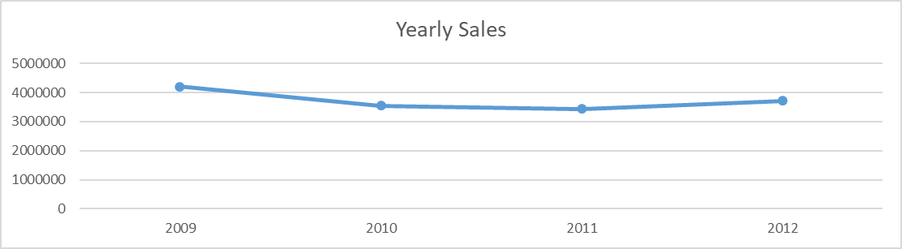
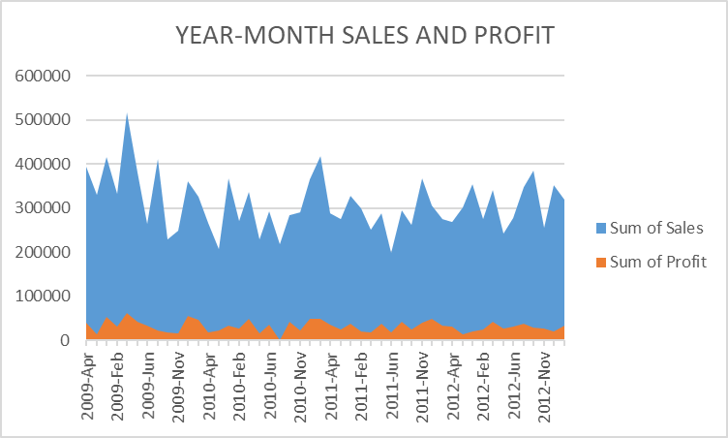
4. ANALYSIS
A new worksheet called ‘summaries’ was created in the Superstores dataset workbook to store all pivot tables and charts to be used in the data report presentation.
The charts below show the sales of Superstores over the years 2009-2012 and the year-month sales and profit, with the highest sales and profit record achieved in 2009-jan and the lowest sales in 2010-Mar.

Slide 8
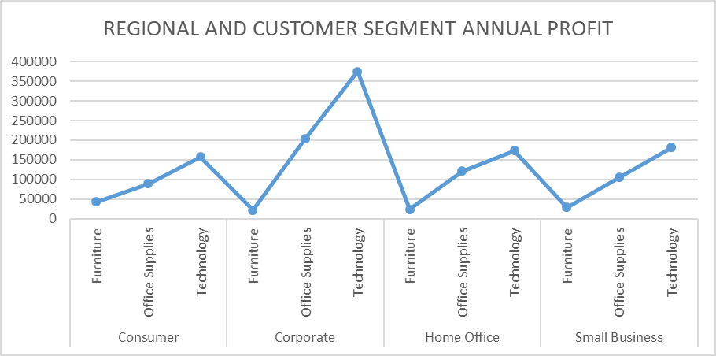
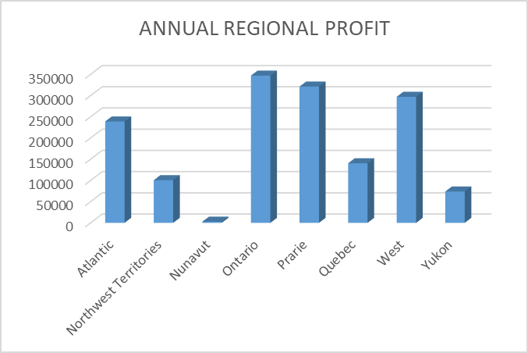
C.
The charts below show the profit of superstores over time, with
Product category with the highest profit being: Technology
Region with the highest profit: Ontario
Customer segment with the highest profit: Corporate

Slide 9
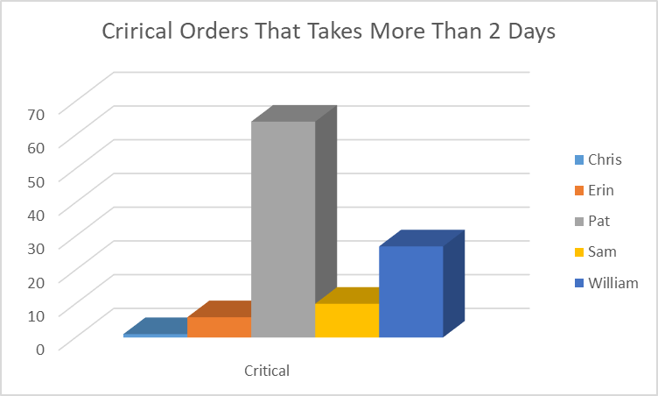
D. Minimum DaystoShip = 0 day
Maximum= 92 days
Median = 2 days
Mode = 2 days
Mean/average = 2 days
E. The number of critical priority orders greater than average daystoship = 108
The region responsible for this key performance indicator + Pat with 64 returned orders

Slide 10
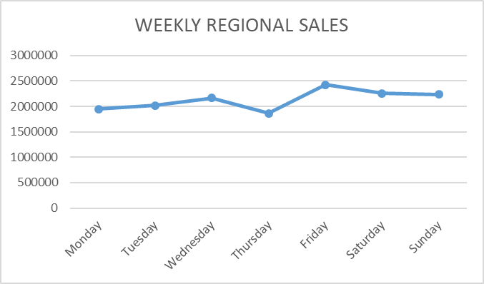
F.
The graph below shows the sales of the superstores of each region based on the days of the week, in the graph it was noted that on Friday, we have the highest number of sales with a value of $2,426,249.074

Slide 11
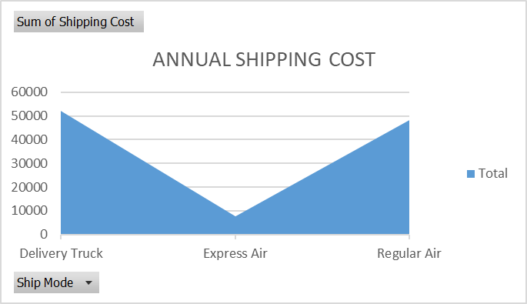
G.
The superstores have 3 mode of shipping, which are;
Delivery Truck cost the most with a value of $51989.41
The average shipping cost across all sales transaction = $12.839

Slide 12
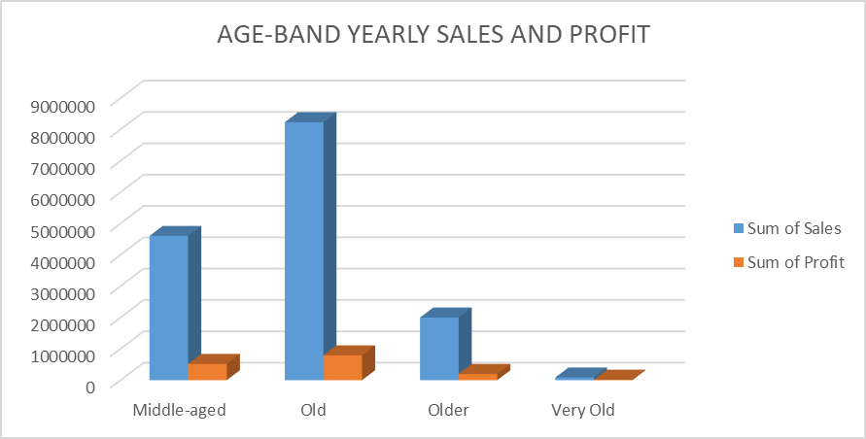
H. The customers are divided into 4 age bands of ages;
30-50: Middle-aged with Revenue = $4,602,638.761 and Profit = $518,359.66
50-70: Old (the most profitable) with Revenue = $8,230,529.76 and Profit= $791,632.72
70-90: Older with Revenue= $1,997,257.523 and Profit= $197,388.17
90-110: Very Old with Revenue= $85,174.78 and Profit= $14,387.43

Slide 13
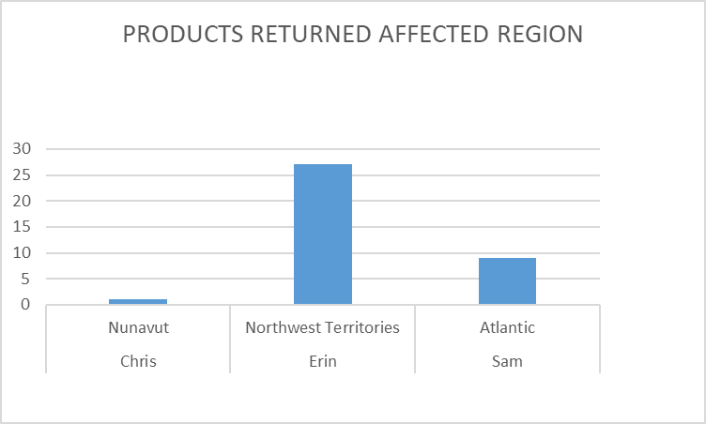
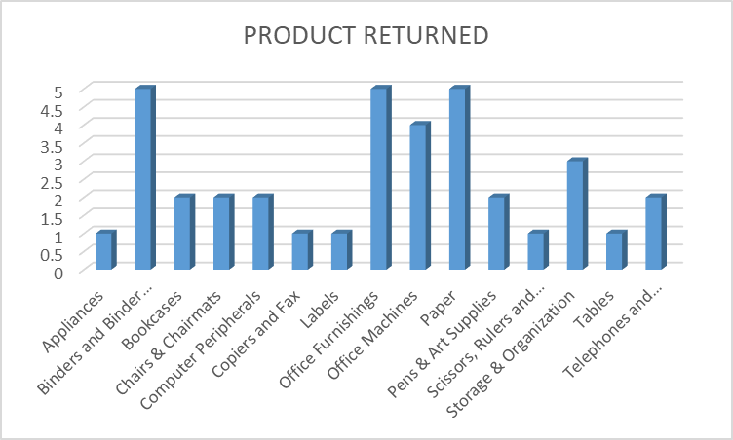
I.
The charts below represent the various drivers of returned orders, of which the following are responsible;
Product category: Office Supplies
Product sub-category: Bindersand Binders accessories, office furnishings and paper
Region: Northwest Territories
Manager: Erin

Slide 14
Revenue lost due to returned orders: $939,081.99
Recommendation: The reason for the returned order should be found first after which some necessary steps should be carried out based on the investigation.
Commercial value after 6 months if percentage of returns went down by 50% = 0.5*$939,081.99 = $469,540.99

Slide 15
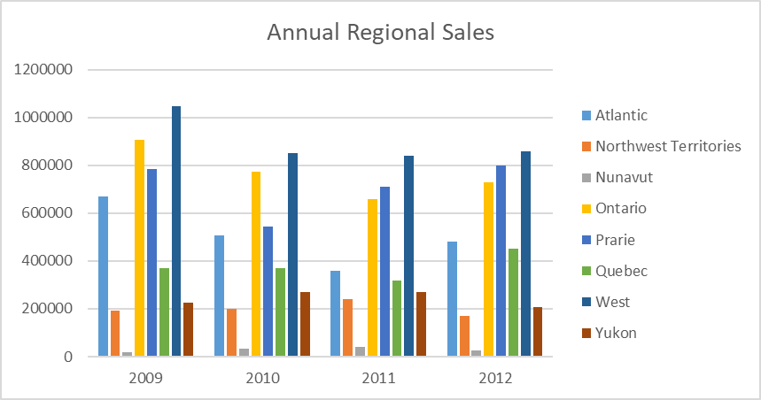
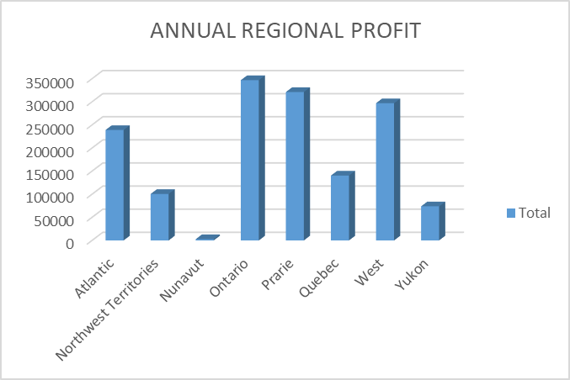
J. The regional manager to be promoted is PAT because even though PAT is responsible for four of the regions (West, Ontario, Quebec and Yukon) , two of the regions are among the top 3 region with the highest sales and profit value, which shows that she is capable enough to handle the position.

Slide 16
CONCLUSION
This report contains all the sales data for Superstores. The raw data contain errors of which had been rectified with various formulas and functions. Some of the recommendations for making business decisions are backed with the data calculated, so the suggestions are valid to a certain extent.
THANKS

